Slide 1
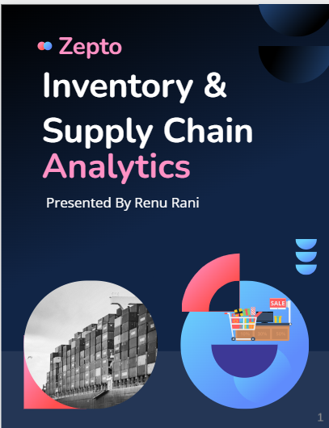

Slide 2
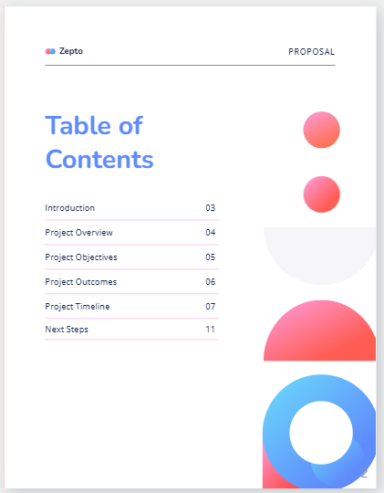

Slide 3
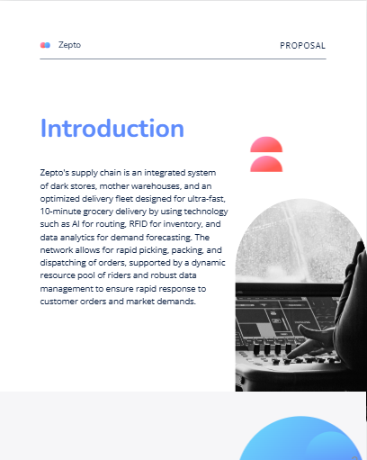

Slide 4
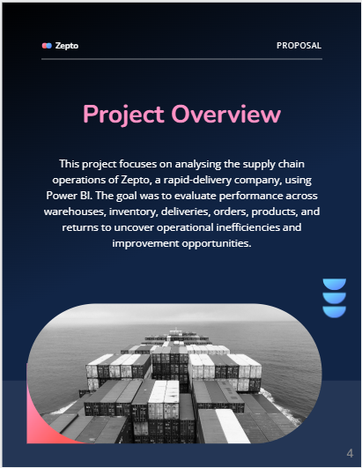

Slide 5
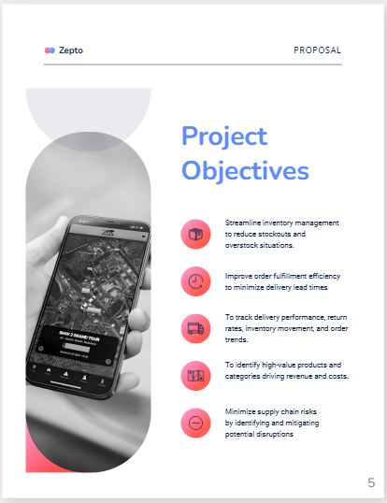

Slide 6
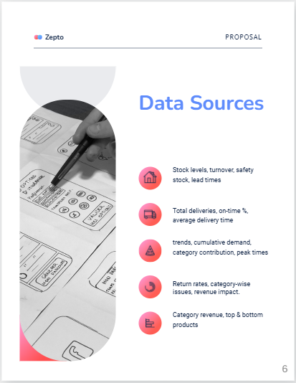

Slide 7
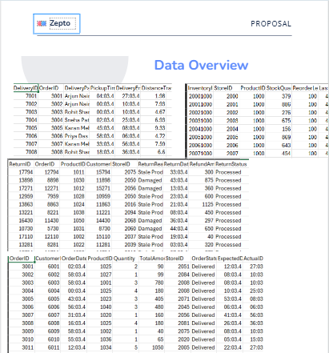
Overview of the excel files data sets
The data has loaded to the Power Bi to transform and clean it for the further analysis

Slide 8
Problem statement if the data set
When I began this project, I was working with a small supply chain dataset from an early-stage startup. The data only covered two months—January and February—which made it both a challenge and an opportunity. Since the dataset was limited, my first step was to carefully structure and clean it in Power BI so it could serve as a strong foundation for analysis.
Once the data was in shape, I started building DAX measures to unlock insights. Even with just two months of information, I was able to highlight important supply chain dimensions that could help the business grow. For example:
Deliveries: I created measures to track delivery timelines and performance, giving an early view of fulfillment reliability.
Stores: I analyzed store-level trends, identifying which outlets were contributing most to sales and where improvements could be made.
Inventory (ABC classification): Using ABC analysis, I categorized products by their consumption value to support smarter stock management and reduce the risk of shortages or overstocking.
Returns: I evaluated return rates and patterns to understand inefficiencies and customer pain points.
Products: I explored category-level performance, identifying which items were driving revenue.
Orders: I mapped out order flows and cumulative patterns to show how demand was building over time.
What I found most valuable in this process was proving that even a limited dataset, if modeled and analyzed correctly, can uncover meaningful insights. By using Power BI’s modeling features and DAX, I was able to transform raw startup data into a clear story of how deliveries, stores, inventory, and products were performing.
This project not only demonstrates my technical skills in Power BI and DAX but also shows how I approach data strategically—starting small, building structure, and scaling insights into actionable recommendations for supply chain decision-making.

Slide 9
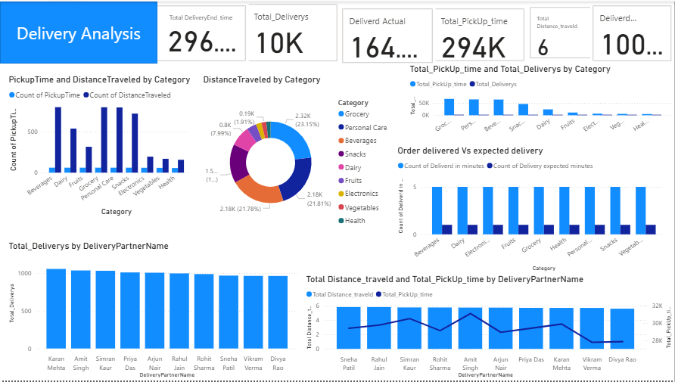

Slide 10
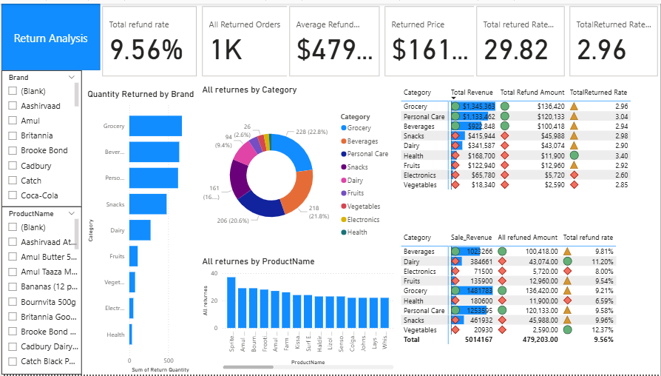

Slide 11
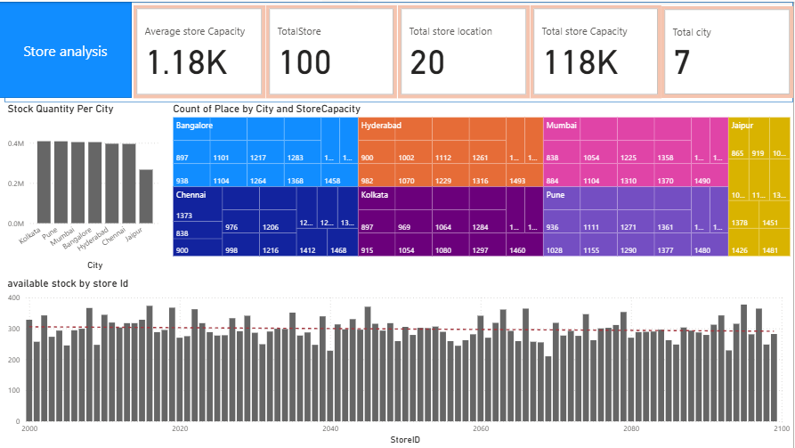

Slide 12
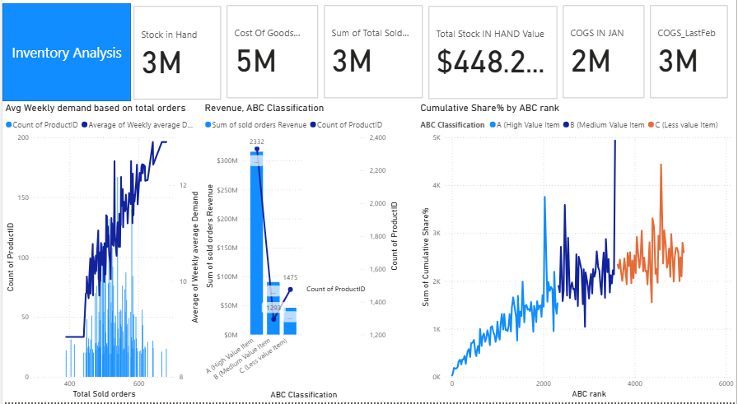

Slide 13
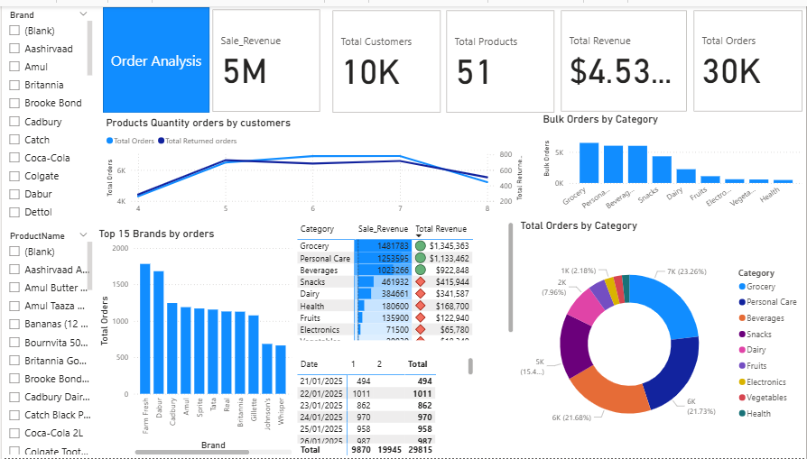

Slide 14
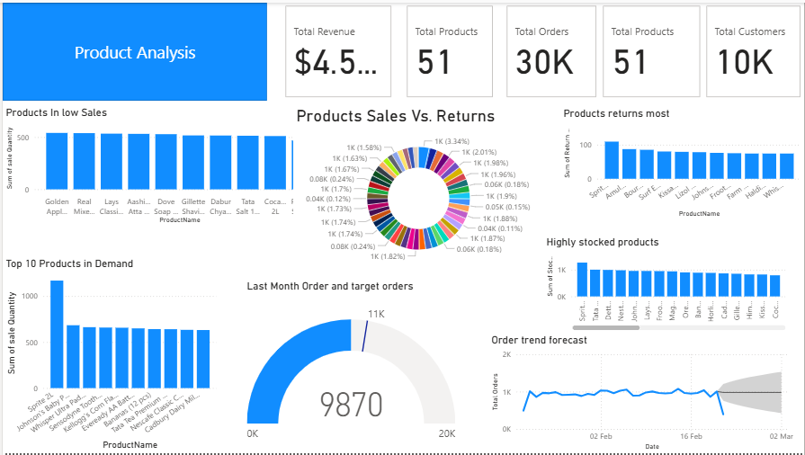

Slide 15
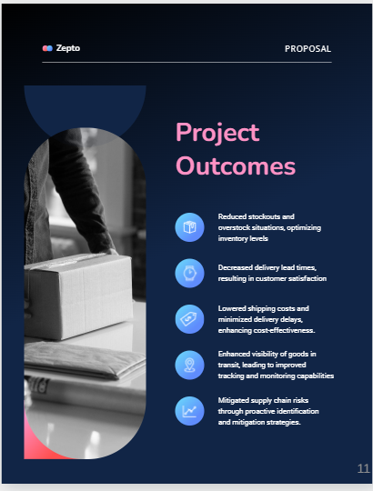

Slide 16
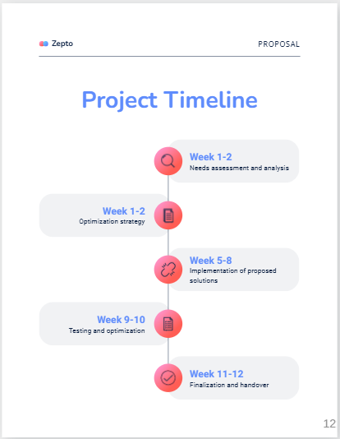

Slide 17
